Slide 1
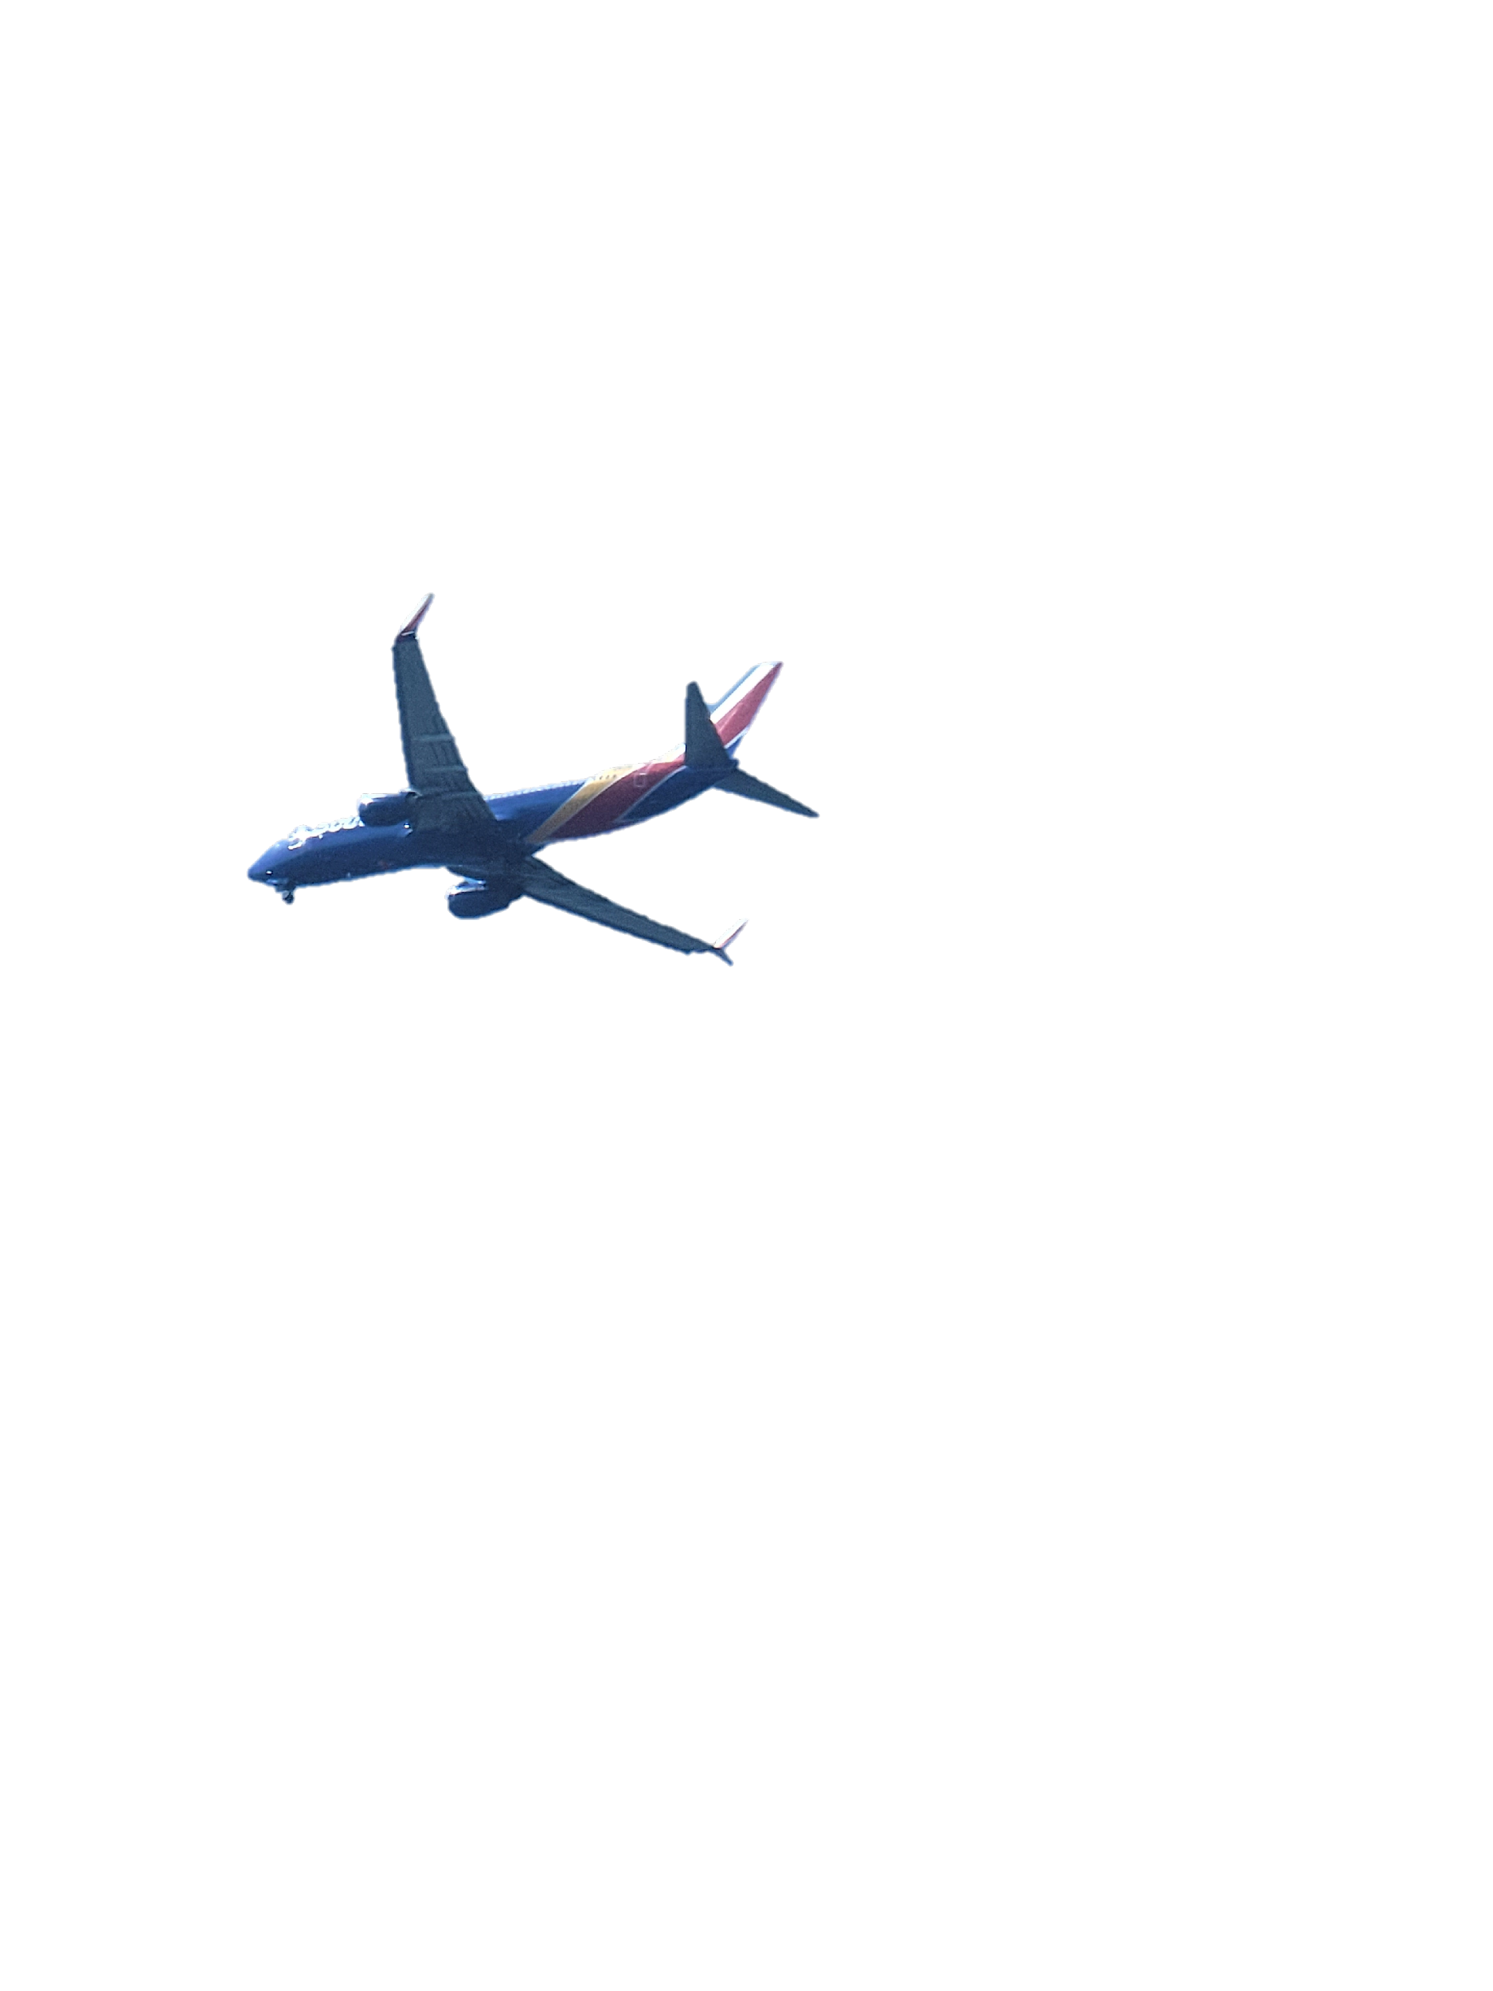
AIRLINE PASSENGER SATISFACTION
IS-603 Decision-Making Support Systems Group-5 Team Members- SAI SRI HARSHA KUMBAM-EF41093 Ramya Jyotsna Neelakantrao -WI30334 Parimal Dhananjay Chamalwar- DN96416

Slide 2
PROJECT DESCRIPTION
https://www.kaggle.com/datasets/teejmahal20/airline-passenger-satisfaction
The dataset for this project is taken from Kaggle called "Airline Satisfaction" and contains information about airline passengers' satisfaction with their travel experience. The data was collected from a survey conducted by a major US airline between October 2019 and January 2020. The dataset has 24 columns and 129,880 rows.
The dataset includes various features related to passengers' travel experience, such as their gender, age, travel class, flight distance, in-flight service, and customer feedback. The target variable is the passenger satisfaction level, which is classified as either "satisfied" or "neutral or dissatisfied."

Slide 3
The hypothesis for this analysis is to identify the key factors which lead to the satisfaction of customers, before analyzing the data our team thought that the main factors will be delays in flights, staff efficiency, and services provided by the airlines.
In the view of the Airline Customer Satisfaction dataset, descriptive modeling is used to identify the areas, which highly impact customer satisfaction.
We have analyzed and visualized the customer data and drawn the trends from that data.

Slide 4
A decision support system (DSS) for the "Airline Passenger Satisfaction" project is designed to help airline companies analyze the dataset and provides insights to the customer experience and improve their business.
We focused on improving the customer satisfaction of a airline company by analyzing the customer satisfaction status.
The ultimate goal of our project is to identify the customer dissatisfied areas and helps airlines to concentrate on the respective areas.

Slide 5
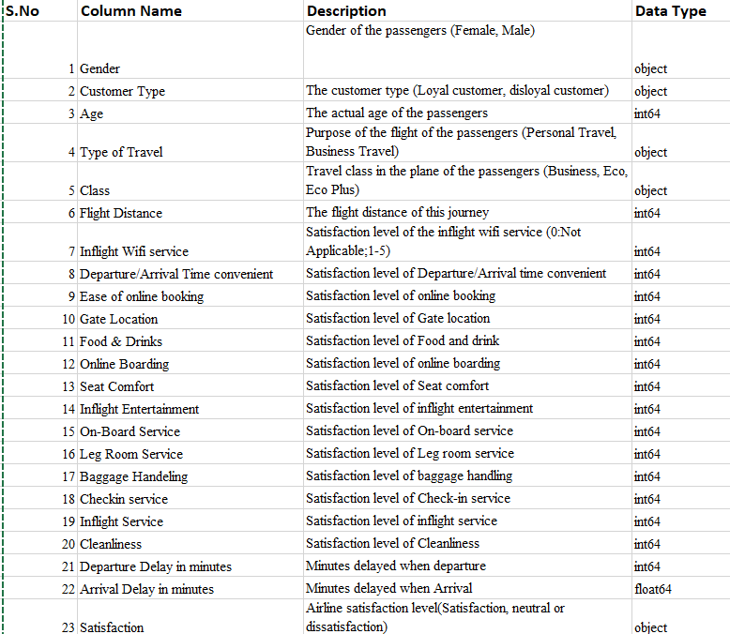
DATA FEATURES
The dataset consisted of 129,880 rows. and 24 features

Slide 6
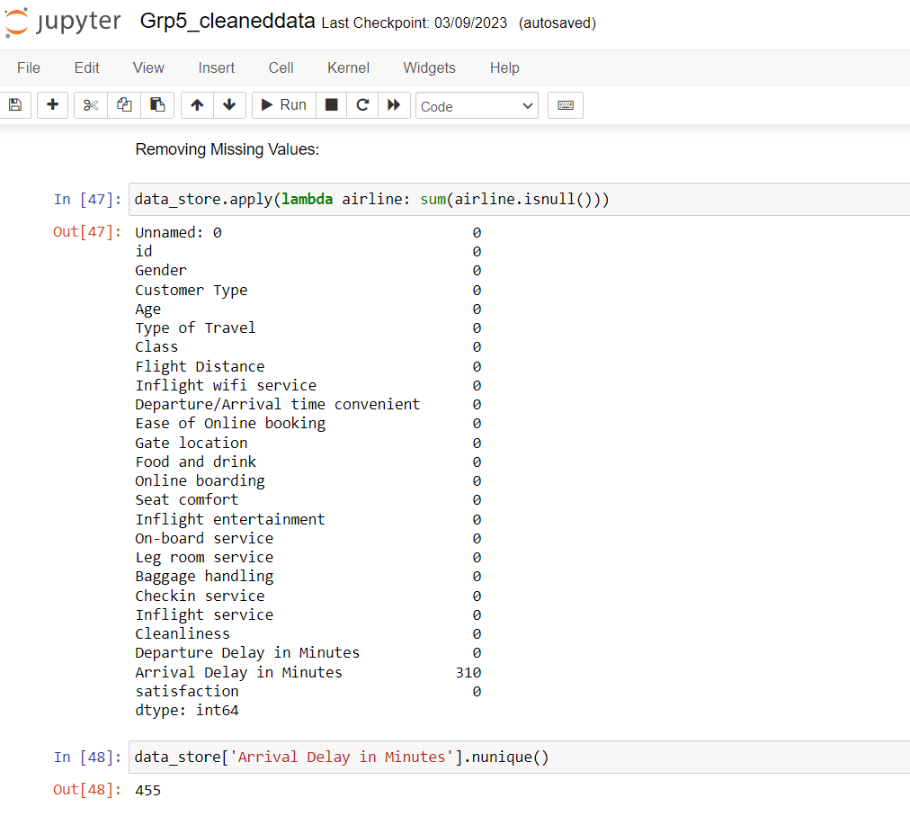
DATA ANALYSIS
We have used Jupyter Notebook to model our dataset and implement in the system.
The first step we applied is we read the data and identified the missing values.
Preliminary analysis of our dataset indicated that we have 310 missing values in 'Arrival delay’.

Slide 7
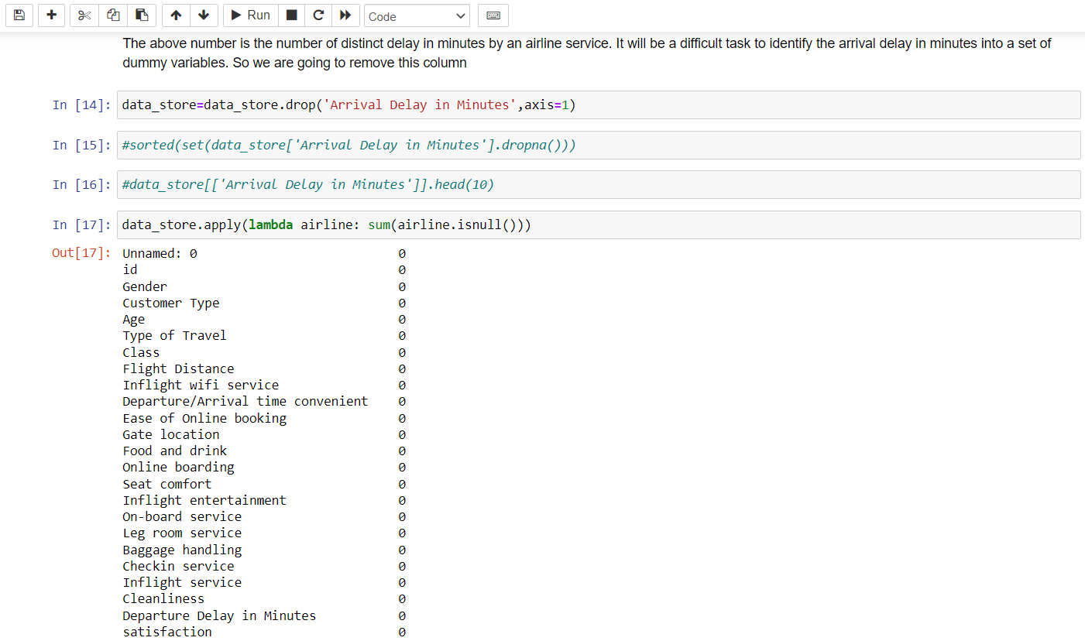
DATA PREPROCESSING
Handling Missing Values
We handled the missing values by dropping the feature ‘Arrival Delay in Minutes’.
The age and Gate location features do not play a huge role in flight satisfaction, and also the gender does not tell us much as seen in the earlier plot. Hence we dropped these values.

Slide 8
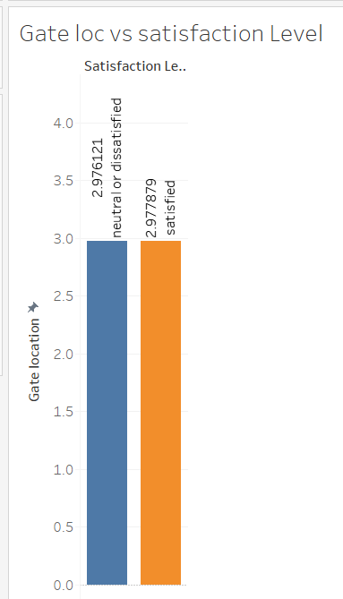
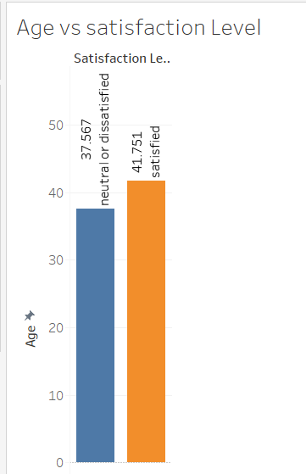

Slide 9
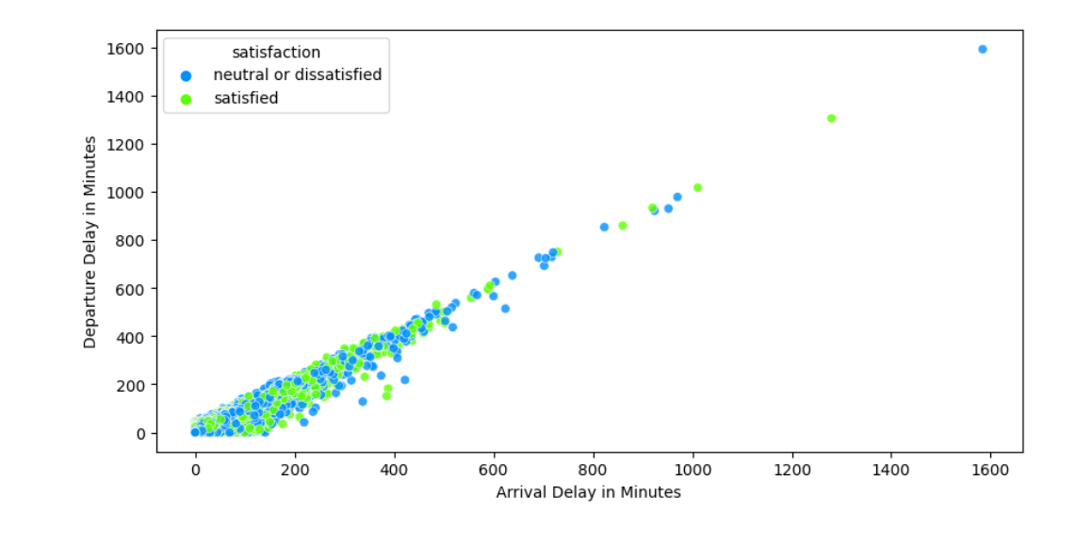
We have 310 missing values in “Arrival delay”. The arrival and departure delay seems to have a linear relationship so we are considering departure delay and dropping the arriving delay feature.

Slide 10
MODEL BUILDING
We used a couple of algorithms and trained with our train data set with the help of WEKA tool to find out the features that stand out.
The accuracy of the models obtained after training are as follows
Decision Tree is 94.59%, AdaBoost is 86.44%, Random Forest is 95.38%, Naive bayes is 84.60%, Logistic regression is 87.38%
Split percentage: 70% , testing : 30%

Slide 11
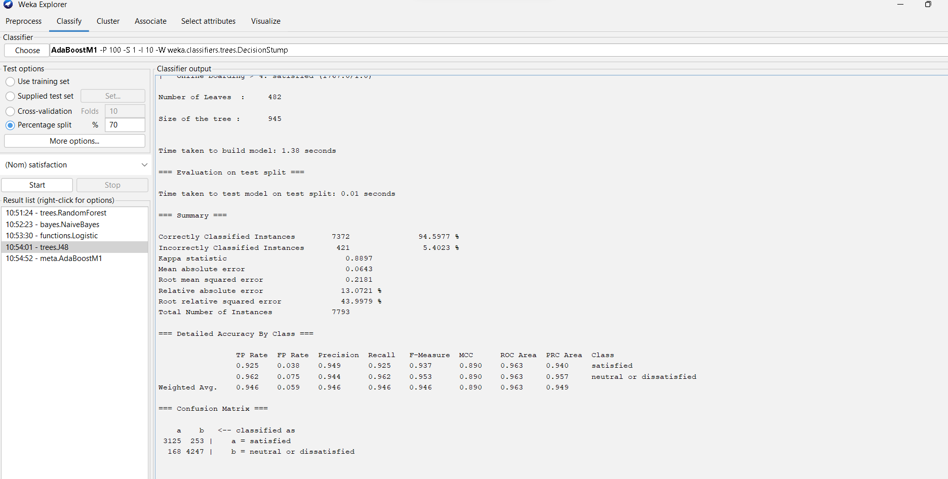
DECISION TREE

Slide 12
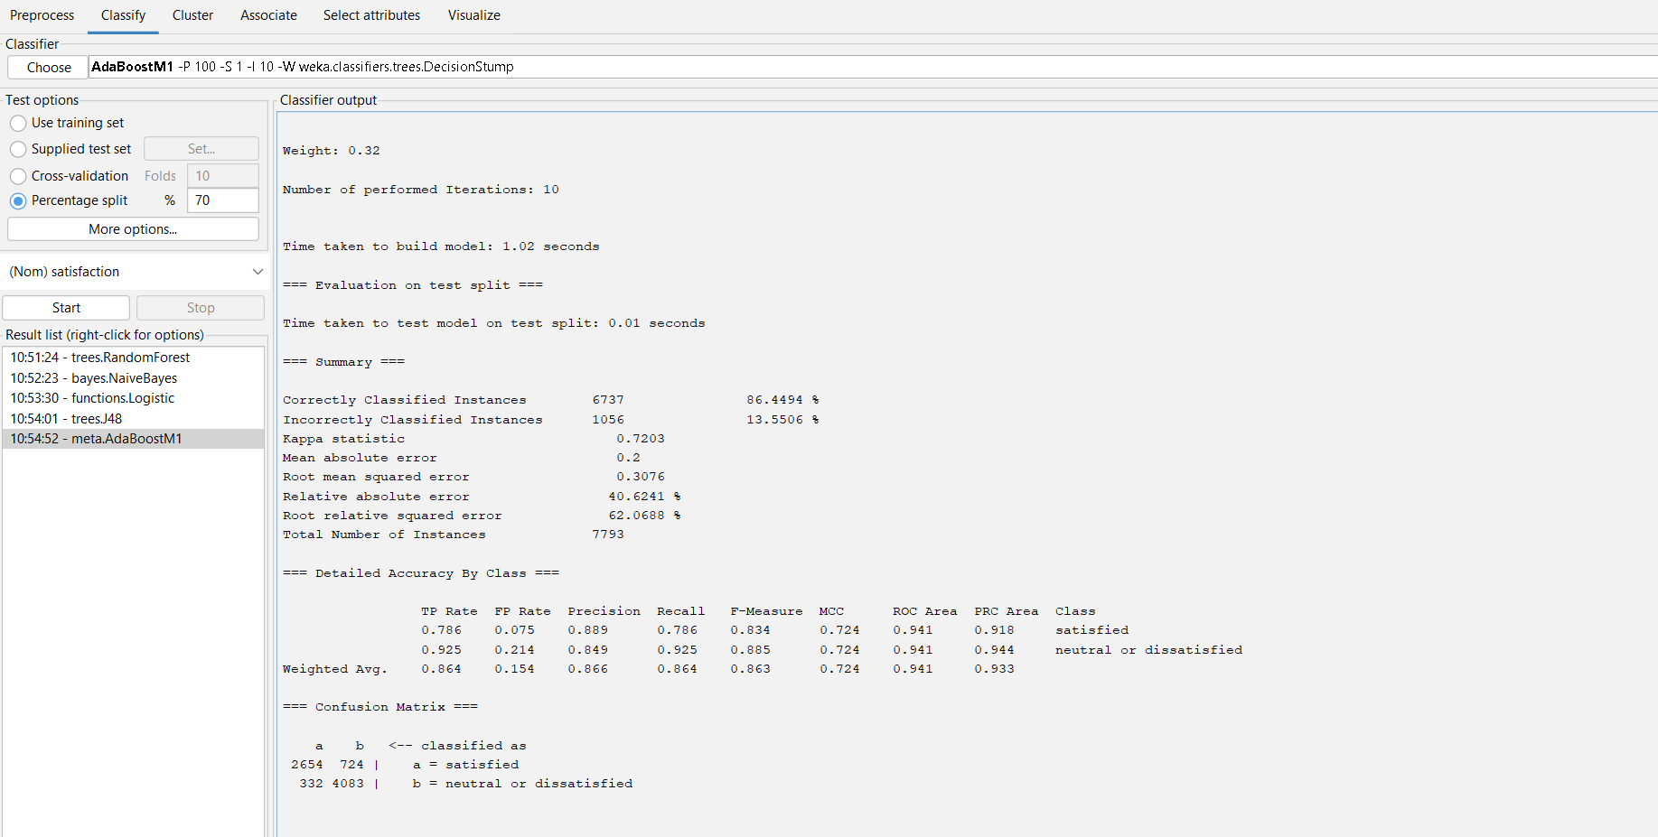
ADABOOST

Slide 13
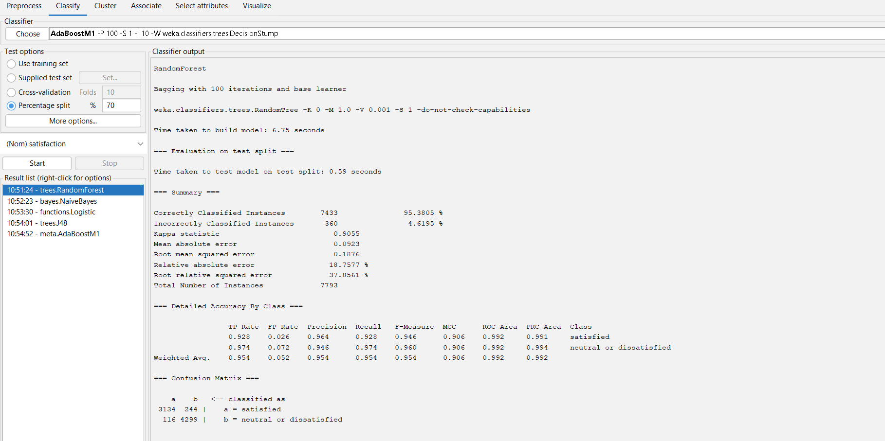
RANDOM FOREST

Slide 14
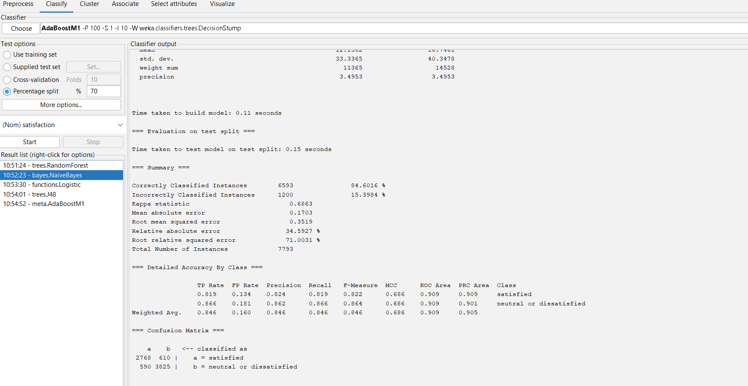
NAIVE BAYES

Slide 15
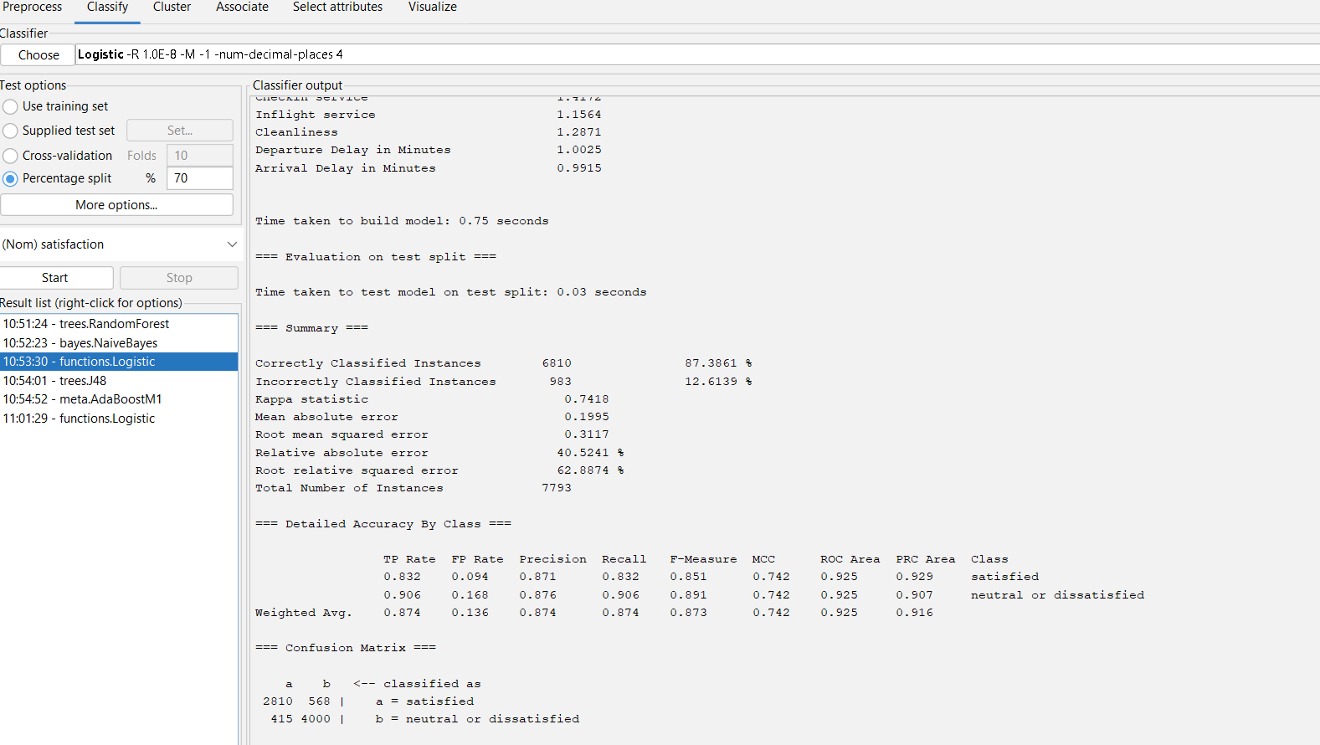
LOGISTIC REGRESSION

Slide 16
VISUALIZATIONS
We have used Tableau as our visualization tool.
We have plotted each feature with the satisfaction of the customer.
We have obtained the following plot for airline passenger customer satisfaction.
At last we visualized all the features against dissatisfaction.

Slide 17
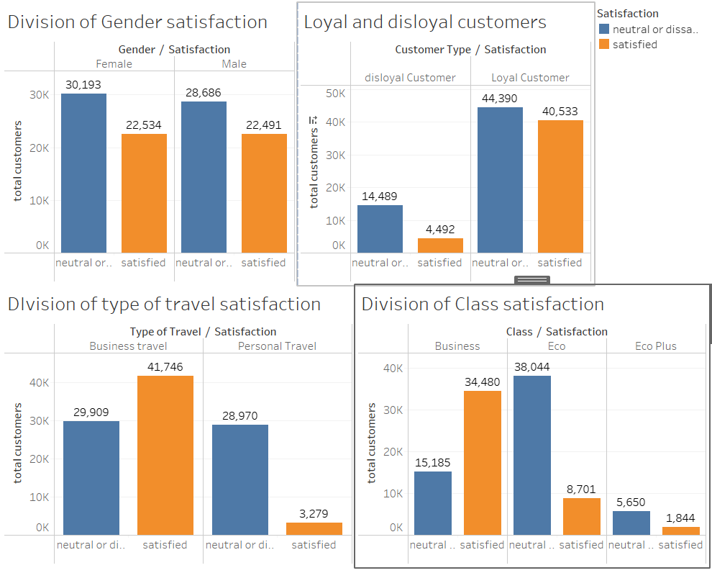

Slide 18
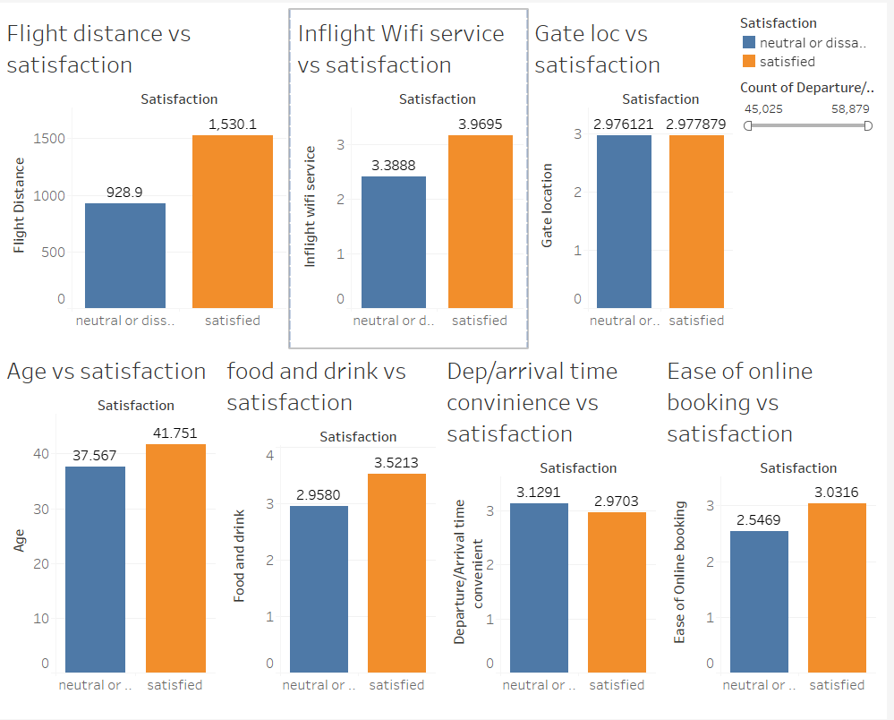

Slide 19
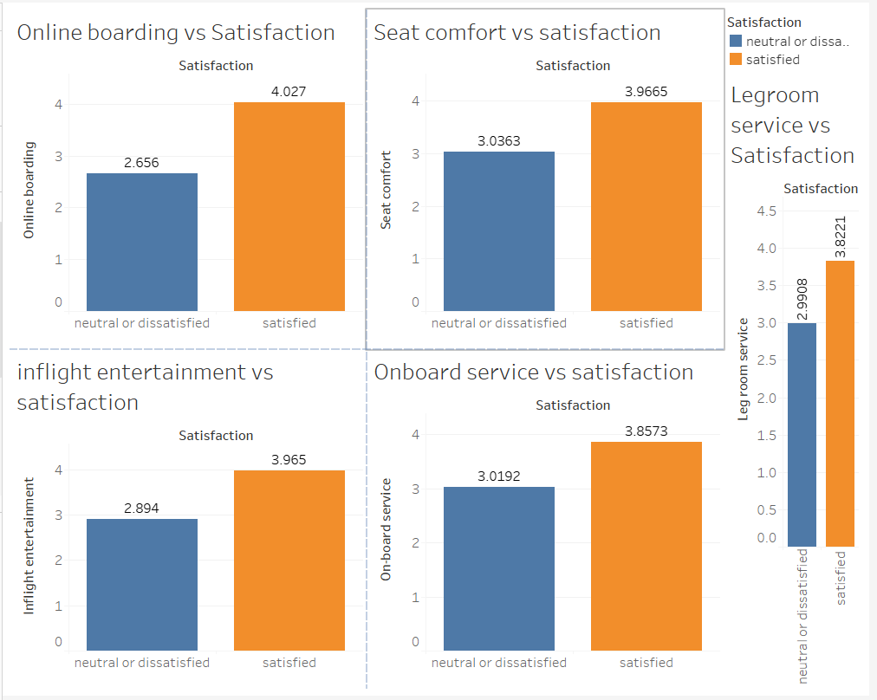

Slide 20
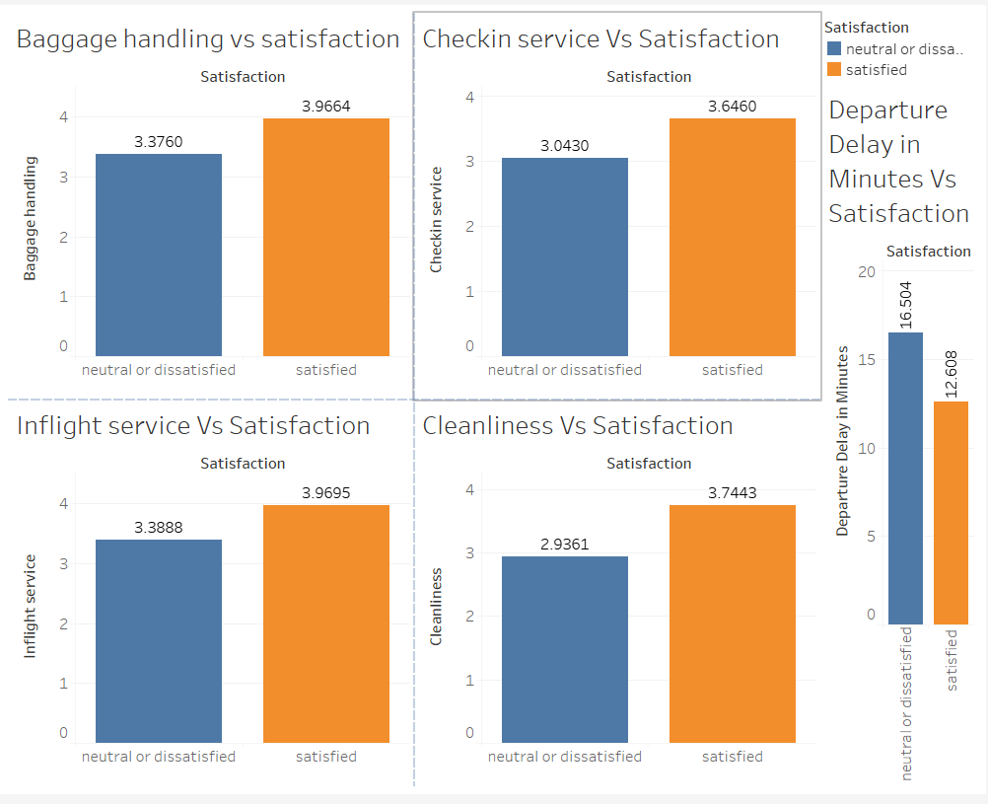

Slide 21
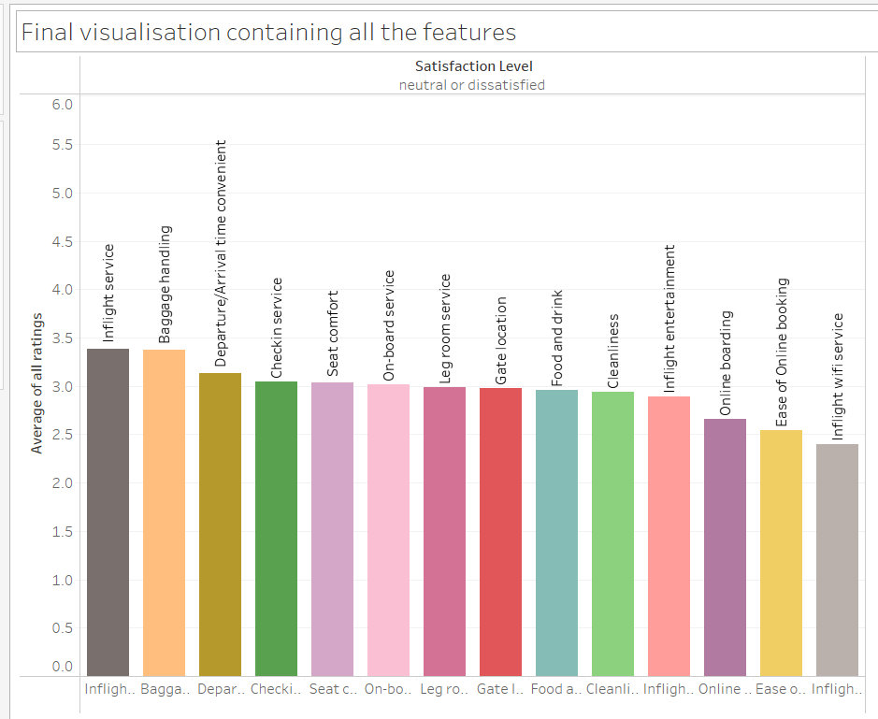
FINAL VISUALIZATION
Observed insights from the visualization are Inflight Services, Baggage handling and Departure or Arrival Delay in flights

Slide 22
Limitations
Data completeness: The dataset's completeness places restrictions on the analysis. It's crucial to handle concerns regarding data quality and take the analysis's potential consequences as we have missing values and one unlabeled data column.
External factor: The dataset is the survey conducted during the time of pandemic i.e., 2019 to 2020 so, it is a past data and trends may have changed .

Slide 23


About Dataset
Data Source: https://www.kaggle.com/
Dataset Link: https://www.kaggle.com/code/samithhegde/airline-passenger-satisfaction

Slide 24
CONCLUSION
In the beginning phase of our analysis we assumed that the features like departure delays in flights, staff efficiency, and inflight services provided by airlines impact customer satisfaction.
By performing descriptive analytics and visualizations we identified the major impacting areas that airlines should concentrate on in order to improve their businesses.
By visualizations it is now clear that inflight service, baggage handling, and departure flight delays are the top three features that affect the satisfaction of the customers.
Finally we concluded that two of our hypotheses that is departure delay and inflight services are justified while the other one failed.

Slide 25
TEAM CONTRIBUTION
Team Member | Contribution
Sai Sri Harsha Kumbam | Data Collection, Data Preprocessing, Data Analysis
Ramya Jyotsna Neelakantrao | Data Analysis, Visualizations
Parimal Dhananjay Chamalwar | Analysis, Model Building

Slide 26
THANK YOU

